Slide 1
Transactions &
Concurrency Control 1
R&G 16/17
There are three side effects of acid. Enhanced long term memory, decreased short term memory, and I forget the third.
- Timothy Leary

Slide 2
Architecture of a DBMS
SQL Client
Completed
Completed
Database Management
System
Completed
Query Parsing
& Optimization
Relational Operators
Completed
Files and Index Management
Completed
Completed
Buffer Management
Completed
Disk Space Management
Database
You are here

Slide 3
Architecture of a DBMS, Part 2
SQL Client
SQL Client
SQL Client
Database Management
System
Database Management
System
Query Parsing
& Optimization
Query Parsing
& Optimization
Database Management
System
Query Parsing
& Optimization
Relational Operators
Relational Operators
Relational Operators
Files and Index Management
Files and Index Management
Files and Index Management
Buffer Management
Buffer Management
Buffer Management
Disk Space Management
Disk Space Management
Disk Space Management
Transaction Manager
You are here
Database

Slide 4
Architecture of a DBMS, Part 3
SQL Client
SQL Client
SQL Client
Database Management
System
Database Management
System
Query Parsing
& Optimization
Query Parsing
& Optimization
Database Management
System
Database Management
System
Query Parsing
& Optimization
Relational Operators
Relational Operators
Relational Operators
Files and Index Management
Files and Index Management
Files and Index Management
Buffer Management
Buffer Management
Buffer Management
Disk Space Management
Disk Space Management
Disk Space Management
Lock Manager
Logging & Recovery
You are here
Database

Slide 5
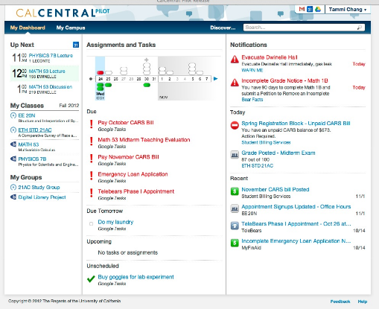
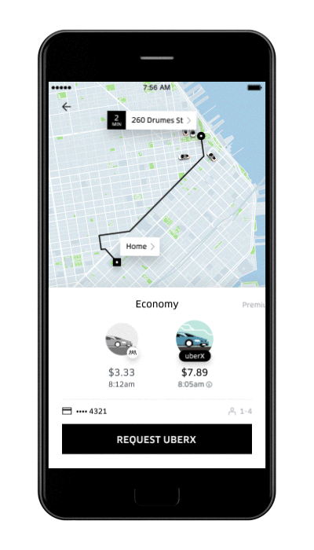
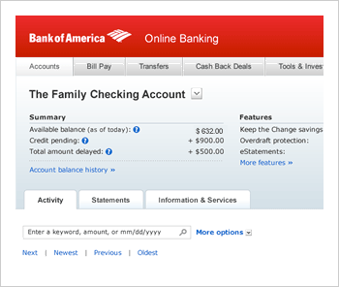
Applications on DBMS
Virtually any compute service that maintains state today is an application on top of some kind of DBMS
  Uber
  Kayak
  Amazon.com
  BankofAmerica
  Pokemon Go

Slide 6
Applications Want Something from the DBMS
Queries and updates of course: what you learned so far!
Real applications are composed of many statements being generated by user behaviors
Many users work with the application at the same time
SQL
SQL
Database Management
System
SQL
SQL
SQL
SQL
SQL

Slide 7
Concurrency Control & Recovery
Part 1: Concurrency Control
  Correct/fast data access in the presence of concurrent work by many users
  Disorderly processing that provides the illusion of order
Part 2: Recovery
  Ensure database is fault tolerant
  Not corrupted by software, system or media failure
  Storage guarantees for mission-critical data
It’s all about the programmer!
  Systems provide guarantees
  These guarantees lighten the load of app writers

Slide 8
Concurrent Execution: Why bother?
Multiple transactions are allowed to run concurrently in the system.
Advantages are twofold:
  Throughput (transactions per second):
    Increase processor/disk utilization → more transactions per second (TPS) completed
      Single core: can use the CPU while another xact is reading to/writing from the disk
      Multicore: ideally, scale throughput in the number of processors
  Latency (response time per transaction):
    Multiple transactions can run at the same time
    So one transaction’s latency need not be dependent on another unrelated transaction
    Or that’s the hope
Both are important!

Slide 9
Motivating Example
SELECT sum(money)
FROM Budget
UPDATE Budget
SET money = money – 500
WHERE pid = 1
UPDATE Budget
SET money = money + 200
WHERE pid = 2
UPDATE Budget
SET money = money + 300
WHERE pid = 3
Two Issues:
Order matters!
Users need a way to say what’s OK

Slide 10
Different Types of Problems
User 1
User 2
INSERT INTO DollarProducts(name, price)
SELECT pname, price
FROM Product
WHERE price <= 0.99
DELETE Product
WHERE price <= 0.99
SELECT count(*)
FROM Product
SELECT count(*)
FROM DollarProducts
What could go wrong?
Inconsistent Reads

Slide 11
Different Types of Problems, Part 2
User 1
User 2
UPDATE Product
SET Price = Price – 10.99
WHERE pname = “CoolToy”
UPDATE Product
SET Price = Price*0.6
WHERE pname = “CoolToy”
What could go wrong?
Lost Update

Slide 12
Different Types of Problems, Part 3
User 1
User 2
UPDATE Account
SET amount = 1000000
WHERE number = “my-account”
SELECT amount
FROM Account
WHERE number = “my-account”
Aborted by the system
What could go wrong?
Dirty Reads

Slide 13
Transactions

Slide 14
Transaction: Concept and Implementation
Major component of database systems
Critical for most applications; arguably more so than SQL

Slide 15
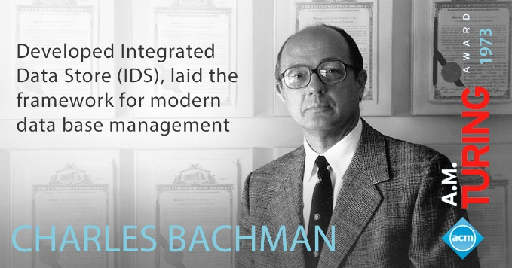
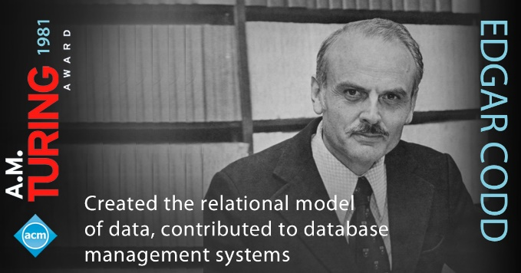
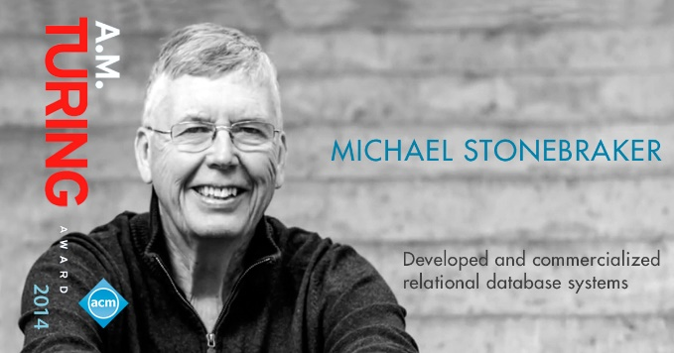
An Aside: Database Turing Awards

Slide 16
What is a Transaction?
A sequence of multiple actions to be executed as an atomic unit
Application View (SQL View):
  Begin transaction
  Sequence of SQL statements
  End transaction
Examples
  Transfer money between accounts
  Book a flight, a hotel and a car together on Expedia

Slide 17
Our Transaction Model
Transaction (“Xact”):
  DBMS’s abstract view of an application program (or activity)
    A sequence of reads and writes of database objects
    Batch of work that must commit or abort as an atomic unit
Xact Manager controls execution of transactions
Program logic is invisible to DBMS!
  Arbitrary computation possible on data fetched from the DB
  The DBMS only sees data read/written from/to the DB
  (Note: modern systems have started rethinking this
  assumption, but we’ll stick with it here)

Slide 18
Transaction Example
Transaction to transfer $100 from account R to account S
    start transaction
    read(R)
    R = R – 100
    write(R)
    read(S)
    S = S + 100
    write(S)
    end transaction
Not seen by the DBMS transaction manager!

Slide 19
ACID: High-Level Properties of Transactions
A tomicity: All actions in the Xact happen, or none happen.
C onsistency: If the DB starts out consistent, it ends up consistent at the end of the Xact
I solation: Execution of each Xact is isolated from that of others
D urability: If a Xact commits, its effects persist.
Note: This is a mnemonic, not a formalism. We’ll do some formalisms shortly.

Slide 20
Isolation (Concurrency)
DBMS interleaves actions of many xacts
  Actions = reads/writes of DB objects
DBMS ensures 2 xacts do not “interfere”
Each xact executes as if it ran by itself.
  Concurrent accesses have no effect on xact’s behavior
  Net effect must be identical to executing all transactions in some serial order
  Users & programmers think about transactions in isolation
    Without considering effects of other concurrent Xacts!

Slide 21
Isolation: An Example
Think about avoiding problems due to concurrency
  If another transaction T2 accesses R and S between steps 4 and 5 of T1, it will see a lower value for R+S.
Isolation easy to achieve by running one Xact at a time
  However, recall that serial execution is not desirable
T1
    start transaction
    read(R)
    R = R – 100
    write(R)
    read(S)
    S = S + 100
    write(S)
    end transaction
T2
    start transaction
    read(R)
    print(R+S)
    end transaction

Slide 22
Atomicity and Durability
A transaction ends in one of two ways:
  Commit after completing all its actions
    “commit” is a contract with the caller of the DB
  Abort (or be aborted by the DBMS) after executing some actions
    Or system crash while the xact is in progress; treat as abort.
Two key properties for a transaction
  Atomicity: Either execute all its actions, or none of them
  Durability: The effects of a committed xact must survive failures.
DBMS typically ensures the above by logging all actions:
  Undo the actions of aborted/failed transactions.
  Redo actions of committed transactions not yet propagated
  to disk when system crashes

Slide 23
Atomicity and Durability, cont.
    start transaction
    read(R)
    R = R – 100
    write(R)
    read(S)
    S = S + 100
    write(S)
    end transaction
Atomicity
  If the transaction fails after step 4 and before step 7
    Money will be “lost” → inconsistent database
  DBMS should ensure that updates of a partially executed transaction are not reflected
Durability
  Once the user hears that the transaction is complete, can rest easy that the $100M was xferred from R to S.

Slide 24
Transaction Consistency
Transactions preserve DB consistency
  Given a consistent DB state, produce another consistent DB state
DB consistency expressed as a set of declarative integrity constraints
  CREATE TABLE/ASSERTION statements
Transactions that violate integrity are aborted
  That’s all the DBMS can automatically check!
Transaction
DBMS
(state1)
DBMS
(state2)
Consistent States
(ICs all satisfied)

Slide 25
Summary
We have seen an overview
ACID Transactions make guarantees that
  Improve performance (via concurrency)
  Relieve programmers of correctness concerns
    Hide concurrency and failure handling!
Two key issues to consider, and mechanisms
  Concurrency control (via two-phase locking)
  Recovery (via write-ahead logging WAL)
We’ll do concurrency control first

Slide 26
Concurrency Control

Slide 27
Concurrency Control: Providing Isolation
Naïve approach - serial execution
  One transaction runs at a time
  Safe but slow
Execution must be interleaved for better performance
With concurrent executions, how does one define and ensure correctness?

Slide 28
Transaction Schedules
T1 | T2
begin
read(A)
write(A)
read(B)
write(B)
commit
 | begin
 | read(A)
 | write(A)
 | read(B)
 | write(B)
 | commit
A schedule is a sequence of actions on data from one or more transactions.
Actions: Begin, Read, Write, Commit and Abort.
R₁(A) W₁(A) R₁(B) W₁(B) R₂(A) W₂(A) R₂(B) W₂(B)
By convention we only include committed transactions, and omit
Begin and Commit.

Slide 29
Serial Equivalence
We need a “touchstone” concept for correct behavior
Definition: Serial schedule
  Each transaction runs from start to finish without any intervening actions from other transactions
Definition: 2 schedules are equivalent if they:
  involve the same transactions
  each individual transaction’s actions are ordered the same
  both schedules leave the DB in the same final state

Slide 30
Serializability
Definition: Schedule S is serializable if:
  S is equivalent to some serial schedule
S
=?
=?

Slide 31
Schedule 1
T1: Transfer $100 from A to B | T2: Add 10% interest to A & B
begin
read(A)
A = A - 100
write(A)
read(B)
B = B + 100
write(B)
commit
 | begin
 | read(A)
 | A = A * 1.1
 | write(A)
 | read(B)
 | B = B * 1.1
 | write(B)
 | commit
Let T1 transfer $100 from A to B
Let T2 add 10% interest to A & B
Serial schedule in which T1 is followed by T2
  Final outcome:
    A := 1.1*(A-100)
    B := 1.1*(B+100)

Slide 32
Schedule 2
Serial schedule in which T2 is followed by T1
  Final outcome:
    A := (1.1*A)-100
    B := (1.1*B)+100
  Different!
    But still understandable
T1: Transfer $100 from A to B | T2: Add 10% interest to A & B
 | begin
 | read(A)
 | A = A * 1.1
 | write(A)
 | read(B)
 | B = B * 1.1
 | write(B)
 | commit
begin
read(A)
A = A - 100
write(A)
read(B)
B = B + 100
write(B)
commit

Slide 33
Schedule 3
T1: Transfer $100 from A to B | T2: Add 10% interest to A & B
begin
read(A)
A = A - 100
write(A)
 | begin
 | read(A)
 | A = A * 1.1
 | write(A)
read(B)
B = B + 100
write(B)
commit
 | read(B)
 | B = B * 1.1
 | write(B)
 | commit
Schedule in which actions of T1 and T2 are interleaved.
This is not a serial schedule
But it is equivalent to schedule 1
  A := (A-100)*1.1
  B := (B+100)*1.1
Hence serializable!

Slide 34
Conflicting Operations
Tricky to check property “leaves the DB in the same final state”
Need an easier equivalence test!
  Settle for a “conservative” test: always true positives, but some false negatives
  I.e. sacrifice some concurrency for easier correctness check
Use notion of “conflicting” operations (read/write)
Definition: Two operations conflict if they:
  Are by different transactions,
  Are on the same object,
  At least one of them is a write.
The order of non-conflicting operations has no effect on
the final state of the database!
  Focus our attention on the order of conflicting operations

Slide 35
Conflict Serializable Schedules
Definition: Two schedules are conflict equivalent if:
  They involve the same actions of the same transactions, and
  Every pair of conflicting actions is ordered the same way
Definition: Schedule S is conflict serializable if:
  S is conflict equivalent to some serial schedule
  Implies S is also Serializable
Note: some serializable schedules are NOT conflict serializable
  Conflict serializability gives false negatives as a test for
  serializability!
  The cost of a conservative test
  A price we pay to achieve efficient enforcement

Slide 36
Conflict Serializability - Intuition
A schedule S is conflict serializable if
  You are able to transform S into a serial schedule by swapping consecutive non-conflicting operations of different transactions
Example
R(A)
R(B)
R(A)
R(B)
W(B)
W(A)
W(B)
W(A)
R(A)
R(A)
W(A)
W(A)
W(B)
R(B)
W(B)
R(B)

Slide 37
Conflict Serializability – Intuition, Part 2
A schedule S is conflict serializable if
  You are able to transform S into a serial schedule by swapping consecutive non-conflicting operations of different transactions
Example
R(A)
R(B)
R(A)
R(B)
W(B)
W(A)
W(B)
W(A)
R(A)
R(A)
W(A)
W(A)
W(B)
R(B)
W(B)
R(B)
R(A)
W(A)
R(B)
W(B)
R(A)
W(A)
R(B)
W(B)

Slide 38
Conflict Serializability – Intuition, Part 3
A schedule S is conflict serializable if
  You are able to transform S into a serial schedule by swapping consecutive non-conflicting operations of different transactions
Example
R(A)
R(B)
R(A)
R(B)
W(B)
W(A)
W(B)
W(A)
R(A)
R(A)
W(A)
W(A)
W(B)
R(B)
W(B)
R(B)
R(A)
W(A)
R(B)
W(B)
R(A)
W(A)
R(B)
W(B)

Slide 39
Conflict Serializability – Intuition, Part 4
A schedule S is conflict serializable if
  You are able to transform S into a serial schedule by swapping consecutive non-conflicting operations of different transactions
Example
R(A)
R(B)
R(A)
R(B)
W(B)
W(A)
W(B)
W(A)
R(A)
R(A)
W(A)
W(A)
W(B)
R(B)
W(B)
R(B)
R(A)
W(A)
R(B)
W(B)
R(A)
W(A)
R(B)
W(B)

Slide 40
Conflict Serializability – Intuition, Part 5
A schedule S is conflict serializable if
  You are able to transform S into a serial schedule by swapping consecutive non-conflicting operations of different transactions
Example
R(A)
R(B)
R(A)
R(B)
W(B)
W(A)
W(B)
W(A)
R(A)
R(A)
W(A)
W(A)
W(B)
R(B)
W(B)
R(B)
R(A)
W(A)
R(B)
W(B)
R(A)
W(A)
R(B)
W(B)

Slide 41
Conflict Serializability – Intuition, cont
A schedule S is conflict serializable if
  You are able to transform S into a serial schedule by swapping consecutive non-conflicting operations of different transactions
Example
R(A)
R(B)
R(A)
R(B)
W(B)
W(A)
W(B)
W(A)
R(A)
R(A)
W(A)
W(A)
W(B)
R(B)
W(B)
R(B)
R(A)
W(A)
R(B)
W(B)
R(A)
W(A)
R(B)
W(B)

Slide 42
Conflict Serializability (Continued)
Here’s another example:
Conflict Serializable or not?
R(A)
W(A)
R(A)
W(A)
NOT!

Slide 43
Conflict Dependency Graph
Ti
Tj
Dependency Graph:
  One node per Xact
  Edge from Ti to Tj if:
    An operation Oi of Ti conflicts with an operation Oj of Tj and
    Oi appears earlier in the schedule than Oj
Theorem: Schedule is conflict serializable if and only if its
dependency graph is acyclic.
Proof Sketch: Conflicting operations prevent us
from “swapping” operations into a
serial schedule

Slide 44
Example
A schedule that is not conflict serializable
T1: R(A), W(A)
T1
T2
Dependency graph

Slide 45
Example, pt 2
A schedule that is not conflict serializable
T1: R(A), W(A),
T2: R(A)
T1
T2
Dependency graph

Slide 46
Example, pt 3
A schedule that is not conflict serializable
T1: R(A), W(A),
T2: R(A), W(A), R(B), W(B)
A
T1
T2
Dependency graph

Slide 47
Example, pt 4
A schedule that is not conflict serializable
T1: R(A), W(A), R(B)
T2: R(A), W(A), R(B), W(B)
A
T1
T2
Dependency graph
B

Slide 48
View Serializability
Alternative notion of serializability: fewer false negatives
Schedules S1 and S2 are view equivalent if:
  Same initial reads:
    If Ti reads initial value of A in S1, then Ti also reads initial value of A in S2
  Same dependent reads:
    If Ti reads value of A written by Tj in S1, then Ti also reads value of A written by Tj in S2
  Same winning writes:
    If Ti writes final value of A in S1, then Ti also writes final value of A in S2
Basically, allows all conflict serializable schedules + “blind writes”
T1: R(A) W(A)
T2: W(A)
T3: W(A)
T1: R(A) W(A)
T2: W(A)
T3: W(A)
view

Slide 49
Notes on Serializability Definitions
View Serializability allows (a few) more schedules than conflict serializability
  But V.S. is difficult to enforce efficiently.
Neither definition allows all schedules that are actually serializable.
  Because they don’t understand the meanings of the operations or the data
Conflict Serializability is what gets used, because it can be enforced efficiently
  To allow more concurrency, some special cases do get handled separately.
  (Search the web for “Escrow Transactions” for example)

